Slide 1
Discussion & Lecture Session Sound & Recording Check
Remote participants:
Log into Join.me
Announce yourself and provide your name on the phone and/or in the chat session
For Screen Sharing utilize your computer
For conference call audio utilize your computer speakers and microphone OR dial into the session with your mobile phone
Onsite participants:
Sit in a good spot near the “speaker phone” if possible
Optionally sign into Join.me… but make sure that your microphone and speakers are muted/off
Test recording by starting recording and then stop recording after a few seconds
Check recording sound when video is released by Join.me

Slide 2

Software Engineering Discussion, Lecture, & Lab Eric Pogue
Agenda for Wednesday, February 5th
Friendly Conversation Topic
Announcements & Prework
Sprint 3 Retrospective
Sprint 4 Planning
Sprint 4 Positioning within The Righteous Triangle & Key Themes
Recall Requirements
Plan-and-Document Project Management Monitoring & Control
Testing & Test-Driven Development
Assignment
Lab
Discussion & Questions welcome at any time… please be present with no phones or email during our time together
Notes:
Sprint 4 Plan & Document Project Management Monitoring & Control

Slide 3
Friendly Conversation Topic

Slide 4
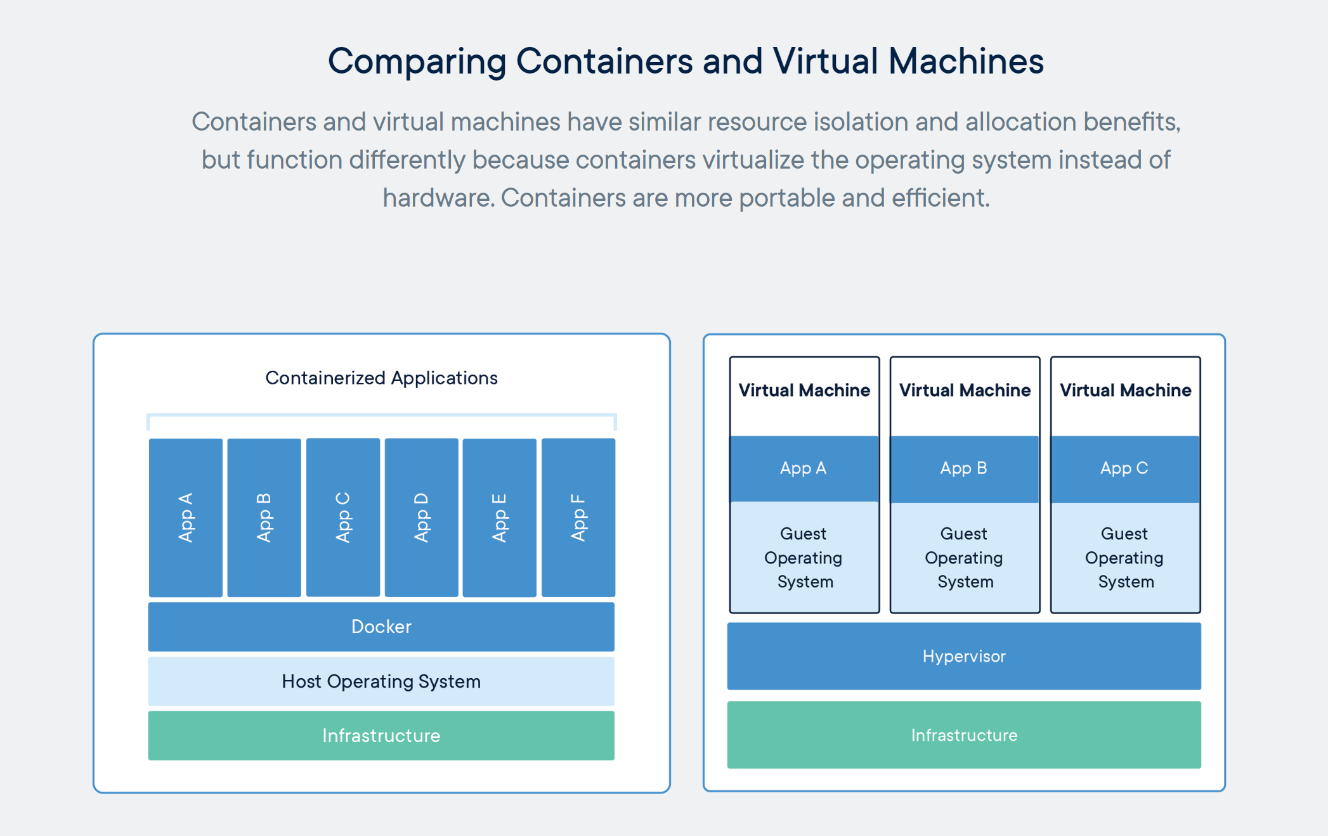
Containers & Docker [link]

Slide 5
Kubernetes & Swarm [link]

Slide 6
Friendly Conversation Bonus Topic: Anyone wish they were on the Shadow Inc development team or the person who contracted them to write the Iowa Democratic Convention application?
Notes:
Security? Usability? Architecture? Testing?

Slide 7
Announcements & Prework

Slide 8
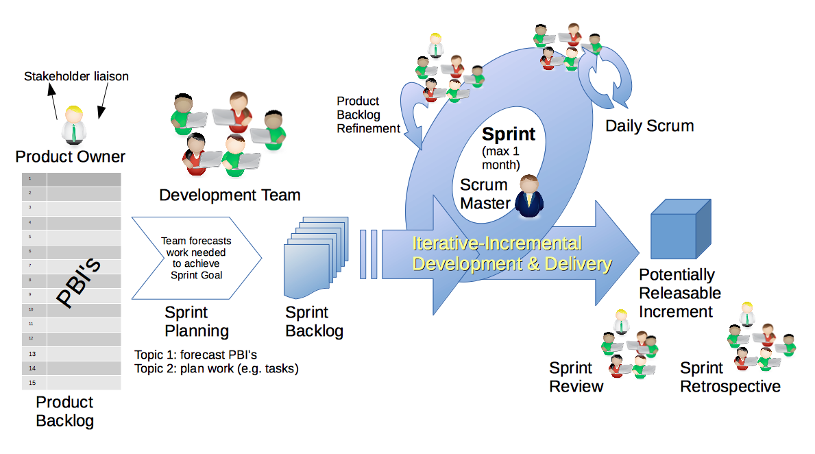
Scrum Process – Sprint Retrospective
By Dr ian mitchell - Own work, CC BY-SA 4.0, Link
Notes:
Calendar, Activities List, and Assignments

Slide 9
Wow! Every single person submitted every single assignment on time.

Slide 10
Feedback?

Slide 11
Sprint 4 Planning

Slide 12
The Righteous Triangle of Software Development
People & Organizations
Technology & Tools
Process & Roles

Slide 13
Sprint 4 Planning – Themes
Sprint 4 Themes Include:
Moving from Requirements to Project Planning/Tracking and Testing
Plan & Document Project Management practices
Testing & Test-Driven Development
Architectural Analysis
Technical software as a service finalization in preparation for Final Projects
Changes & Clarifications in Syllabus including Exams and Schedule
Continued move toward less prescriptive assignments
Notes:
Grace period until Monday morning a 6am CT

Slide 14
Scrum Process – Sprint Planning
By Dr ian mitchell - Own work, CC BY-SA 4.0, Link

Slide 15
Sprint 4 Planning (external)

Slide 16
Plan-and-Document Project Management practices
Notes:
Project Plans, Tracking, Managing

Slide 17
The Righteous Triangle of Software Development
People & Organizations
Technology & Tools
Process & Roles

Slide 18
Waterfall vs Iterative vs Agile Requirements
 | Waterfall | Iterative | Agile
References | United States Department of Defense: DOD-STD-2167A (1985) | Rational Unified Process (RUP) Open Unified Process | Scrum Kanban Scaled Agile Framework (SAFe)
Priorities | Planning and predictability | Architecture, modeling, and efficiency through early detection & fixing of issues (verification) | Responsiveness to feedback, efficiency through engineering practices, early detection & fixing of issues, and validation
Principles | Execute phases sequentially: Requirements Analysis Design Coding Testing and Operations Define and commit to Scope, Cost, and Timeline “early” Implement strict Change Control | Develop and test iteratively Manage requirements Use components Model visually Verify quality Control changes | Develop, test, deploy, and release iteratively Capture lightweight near term requirements Empower teams Allow requirements to evolve but maintain fixed timelines Apply engineering practices and systems thinking (e.g. TDD) Integrate early user feedback into remaining plan Maintain a collaborative approach between all stakeholders
Notes:
The views on testing and change management have changed dramatically as organizations have moved from Waterfall to Iterative to Agile development lifecycles.
Successful Agile (and Iterative) Development REQUIRES better application design, development techniques, and testing practices.
Testing and lack of defects are not the end goal. A higher quality more usable more cost-effective product is the goal.
Requirements:
Waterfall:
Full project requirements upfront
Inconsistent industry capture techniques
Tend to be verbose requirements with formal signoff
Change requests needed
Estimation bottom up detailed estimates sometimes function points
Iterative:
Mostly upfront

Slide 19
Requirements – Waterfall
When working in a Waterfall SDLC Requirements are generally:
Captured up front (before any design or development)
Documented in a variety of formats
Verbose
Estimated in detail using bottom-up estimating techniques (sometime Function Points)
Risk Analysis & Mitigaton
Signed off on
Managed with change requests
Notes:
Grace period until Monday morning a 6am CT

Slide 20
Requirements – Iterative (RUP)
When working in an Iterative (RUP) SDLC Requirements are generally:
Captured primarily up front but updated during design
Documented in Use Cases
Moderately verbose
Estimated using Use Case points
Signed off on with an understanding that minor changes are likely
Managed with change requests
Notes:
Grace period until Monday morning a 6am CT

Slide 21
Requirements – Agile (Scrum)
When working in an Agile (Scrum) SDLC Requirements are generally:
Captured before each sprint
Documented using Stories (light weight)
In Scaled Agile Epics & Features are also used
Only detailed as needed
Estimated using Story Points (very light weight)
Immutable for current sprint
Change is encouraged for future sprints
Notes:
Final Topics:
SMART: Specific, Measurable, Achievable, Relevant, and Time-boxed
Be very careful attempting to measure productivity across teams
Story Points vs Use Case Points vs Function Points

Slide 22
Requirements
Final Thoughts:
SMART Stories: Specific, Measurable, Achievable, Relevant, and Time-boxed
Be very careful attempting to measure productivity across teams
Story Points vs Use Case Points vs Function Points
User Experience is a big deal and often overlooked
Notes:
Final Topics:

Slide 23
Plan-and-Document Project Management Monitoring & Control
Notes:
Project Plans, Tracking, Managing

Slide 24
Waterfall vs Iterative vs Agile Project Management & Testing
 | Waterfall | Iterative | Agile
References | United States Department of Defense: DOD-STD-2167A (1985) | Rational Unified Process (RUP) Open Unified Process | Scrum Kanban Scaled Agile Framework (SAFe)
Priorities | Planning and predictability | Architecture, modeling, and efficiency through early detection & fixing of issues (verification) | Responsiveness to feedback, efficiency through engineering practices, early detection & fixing of issues, and validation
Principles | Execute phases sequentially: Requirements Analysis Design Coding Testing and Operations Define and commit to Scope, Cost, and Timeline “early” Implement strict Change Control | Develop and test iteratively Manage requirements Use components Model visually Verify quality Control changes | Develop, test, deploy, and release iteratively Capture lightweight near term requirements Empower teams Allow requirements to evolve but maintain fixed timelines Apply engineering practices and systems thinking (e.g. TDD) Integrate early user feedback into remaining plan Maintain a collaborative approach between all stakeholders
Notes:
Project Manager positioning

Slide 25
Complex Dependencies
Notes:
Critical Path… Light Weight long-term planning

Slide 26
Plan & Document Project Management Monitoring & Control
Project management is the practice of initiating, planning, executing, controlling, and closing the work of a team to achieve specific goals and meet specific success criteria at the specified time. The primary challenge of project management is to achieve all of the project goals within the given constraints.^{[1]} This information is usually described in project documentation, created at the beginning of the development process. The primary constraints are scope, time, quality and budget.^{[2]}
The objective of project management is to produce a complete project which complies with the client's objectives. In many cases the objective of project management is also to shape or reform the client's brief to feasibly address the client's objectives. Once the client's objectives are clearly established, they should influence all decisions made by other people involved in the project.
From Wikipedia, the free encyclopedia
Notes:
What is the term that Jeremy used for doing it in the place?

Slide 27
Plan & Document Project Management Monitoring & Control (continued)
A project is a temporary endeavor designed to produce a unique product, service or result with a defined beginning and end (usually time-constrained, and often constrained by funding or staffing) undertaken to meet unique goals and objectives, typically to bring about beneficial change or added value.^{[3][4]} The temporary nature of projects stands in contrast with business as usual (or operations),^{[5]} which are repetitive, permanent, or semi-permanent functional activities to produce products or services. In practice, the management of such distinct production approaches requires the development of distinct technical skills and management strategies.^{[6]}
From Wikipedia, the free encyclopedia
Notes:
Product Focus versus Project Focus

Slide 28
Test-driven Development (TDD)
Notes:
Project Plans, Tracking, Managing

Slide 29
Test-driven Development (TDD)
Test-driven development (TDD) is a software development process that relies on the repetition of a very short development cycle: requirements are turned into very specific test cases, then the code is improved so that the tests pass. This is opposed to software development that allows code to be added that is not proven to meet requirements.
American software engineer Kent Beck, who is credited with having developed or "rediscovered"^{[1]} the technique, stated in 2003 that TDD encourages simple designs and inspires confidence.^{[2]}
Test-driven development is related to the test-first programming concepts of extreme programming, begun in 1999,^{[3]} but more recently has created more general interest in its own right.^{[4]}
Programmers also apply the concept to improving and debugging legacy code developed with older techniques.^{[5]}
From Wikipedia, the free encyclopedia
Notes:
What is the term that Jeremy used for doing it in the place?

Slide 30
Software Testing Overview
Software Testing [link] is important because, if done right, it can help us find and fix problems earlier and make our system delivery process less immobile, rigid, and fragile.
As future Software Engineers , we are going to:
Understand testing within the various Software Development Lifecycles
Understand testing terminology
Know how to develop applications that are easier to test
Understand Unit Testing and Automated Testing
Notes:
Never underestimate the value of good design and implementation (for testability, encapsulation, etc.) on the economics of testing. You can’t afford to test in quality!
Developers are responsible for product quality. Tester should be able to minimize that chance that a defect makes it to production.
We test to find defects and/or to validate that we have not introduced new defects.
Defects are exponentially more expensive to fix the longer the exist.
Performance issues are often the most difficult and expensive defects to fix. They are often not found until the application if running under production load… which is often only when it is in production.
Unit - $200
Integration - $600
User Acceptance - $6,000
Production - $100,000+
The permutations of modern software features, data, tools, environments, etc. quickly becomes unmanageable. Testability needs to be goal of nearly all non-trivial applications.
Dave Cutler of Windows NT fame had a quote. I wish I could remember the exact words, but it went something like, “I hate having testers because they give developers the false hope that someone else can save them from their sins.”

Slide 31
Software Testing “Truths”
Never underestimate the value of good design and implementation (for testability, encapsulation, etc.) on the economics of testing… You can’t afford to test in quality!
Defects are exponentially more expensive to fix the longer the exist.
Unit - $200
Integration - $600
User Acceptance - $6,000
Production - $100,000+
Performance issues are often the most difficult and expensive defects to fix. They are often not found until the application if running under production load… which is often only when it is in production.
The permutations of modern software features, data, tools, environments, etc. quickly becomes unmanageable. Testability needs to be goal of nearly all non-trivial applications.

Slide 32
Software Testing “Truths” (continued)
Developers need to be responsible for product quality. Tester should be able to minimize that chance that a defect makes it to production.
Dave Cutler of Windows NT fame had a quote. I wish I could remember the exact words, but it went something like, “I hate having testers because they give developers the false hope that someone else can save them from their sins.”

Slide 33
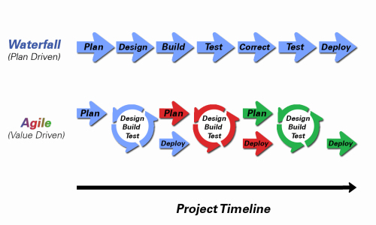
Object-Oriented Programming within Various Development Methodologies
Notes:
Development Methodology and Software Development Lifecycle (SDLC) are often used interchangeably.
The Iterative development methodology is not depicted here as even the mainstays and inventors of the Iterative development methodology seem to be moving toward agile. Plus as Waterfall “holdouts” move, they seem to be moving directly toward Agile. Can you start to see my biases?
Development Methodologies (SDLCs) are a future Bonus Topic. There are several optional slides t the end of this deck. Let me know if you would like to have a more formal overview of the topic as part of this class. I have a passion in this area.
Object oriented-programming concepts/practices evolve and reprioritize depending on the development methodology.
For example, in Waterfall (as well as in Iterative) object-oriented design often play a critical role in the (big upfront) design activities. UML diagrams and project artifacts are often important to the overall project success. (opinion) Practical reality has been that these design artifacts often do not reflect the actual implementation and are rarely maintained or updated.
The Agile practitioners do not reject these design artifacts. However, the focus on shorter time horizons, evolving architecture, and working code changes the value proposition for object-oriented practices to more focus on the build, test, enhance activities.

Slide 34
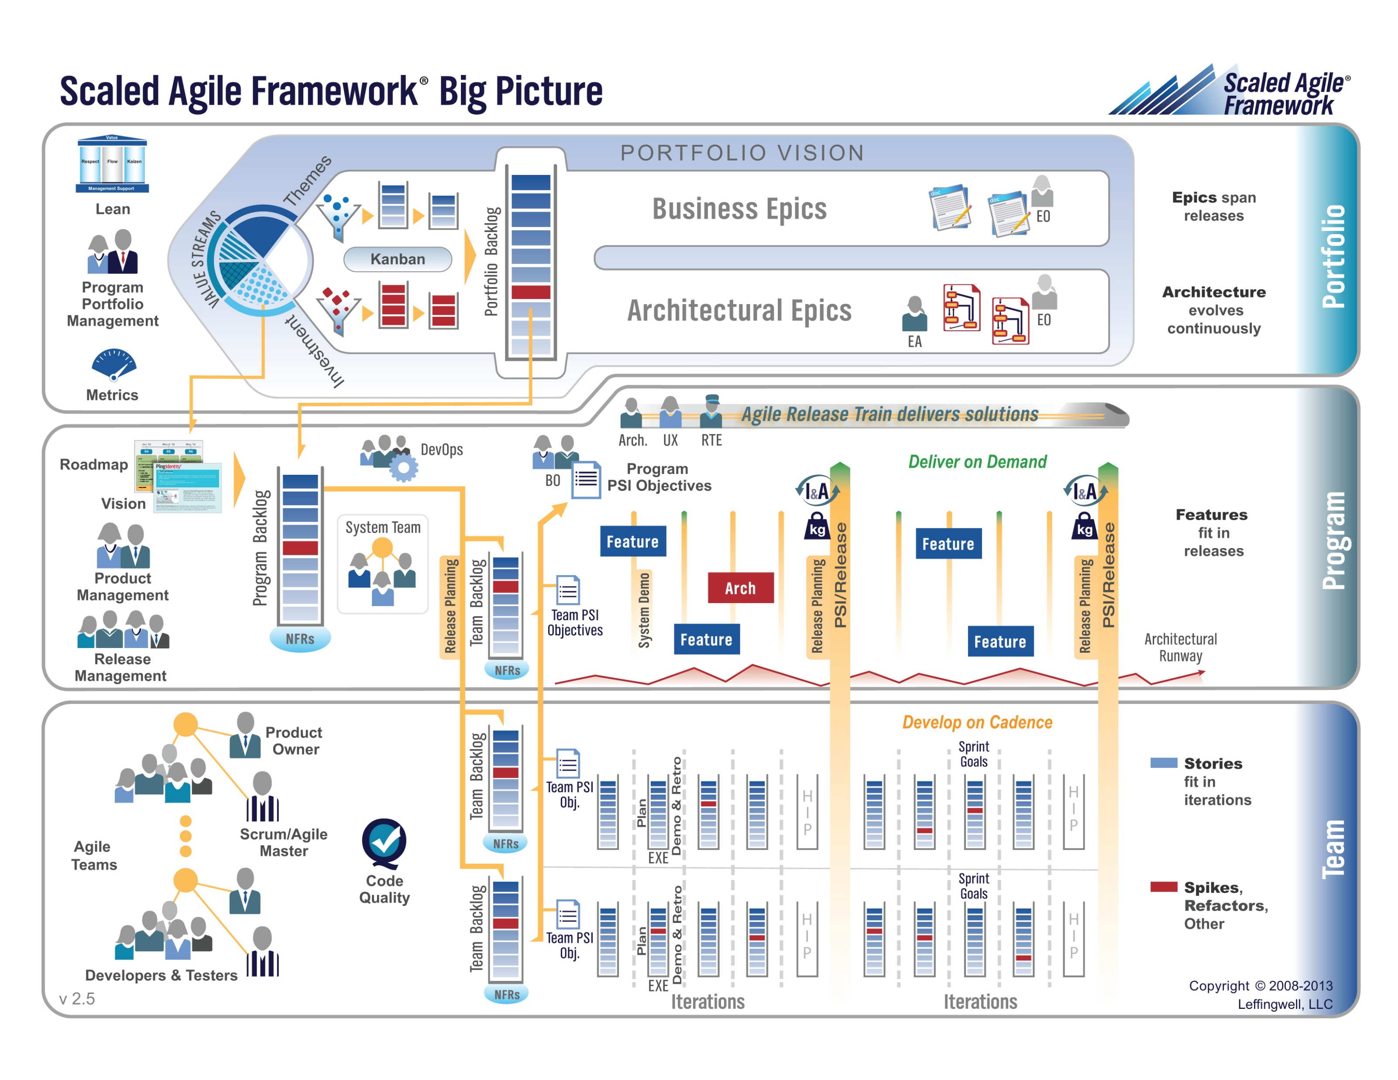

Slide 35
Waterfall vs Iterative vs Agile Testing
 | Waterfall | Iterative | Agile
References | United States Department of Defense: DOD-STD-2167A (1985) | Rational Unified Process (RUP) Open Unified Process | Scrum Kanban Scaled Agile Framework (SAFe)
Priorities | Planning and predictability | Architecture, modeling, and efficiency through early detection & fixing of issues | Responsiveness to feedback, efficiency through engineering practices, early detection & fixing of issues
Principles | Execute phases sequentially: Requirements Analysis Design Coding Testing and Operations Define and commit to Scope, Cost, and Timeline “early” Implement strict Change Control | Develop and test iteratively Manage requirements Use components Model visually Verify quality Control changes | Develop, test, deploy, and release iteratively Capture lightweight near term requirements Empower teams Allow requirements to evolve but maintain fixed timelines Apply engineering practices and systems thinking (e.g. TDD) Integrate early user feedback into remaining plan Maintain a collaborative approach between all stakeholders
Notes:
The views on testing and change management have changed dramatically as organizations have moved from Waterfall to Iterative to Agile development lifecycles.
Successful Agile (and Iterative) Development REQUIRES better application design, development techniques, and testing practices.
Testing and lack of defects are not the end goal. A higher quality more usable more cost effective product is the goal.

Slide 36
Testing Terms
Important testing terms include:
Unit Testing: developer testing their own code
Integration Testing: development team testing their full code
System Testing: multiple development teams testing a full system or systems
Performance Testing: testing performance at the Unit, Integration, and/or System level
Manual Testing: a person using the application often running test scenarios
Automated Testing: a group of automated tests that run on the application in the Unit, Integration, System, or Performance testing areas
UI Automated Testing attempts to exercise the application be reproducing user events (key & mouse events)
API Automated Testing occurs at the function/method API level (JUnit for example)

Slide 37
Testing Terms
Important testing terms (continued):
Verification: does the application perform as expected
Validation: does the application provide the business benefit that was expected
Behavioral Testing: verifying that the correct functions were called with the correct parameters
State Testing: focuses on the results of those calls

Slide 38
Automated Testing
Unit testing can be done in two ways − manual testing and automated testing.
Automated testing has become a more important part of effective software testing. The pros of Automated Testing include:
Repeatable tests that are quick to run and can support Iterative and Agile development
Very effective in validating environments and doing “smoke tests” to make sure a new build meets a minimal set of requirements
Supports Performance Testing very effectively
Very inexpensive and quick to repeat testing and validate fixes
Various implications include UI, API, and Unit automation tests… each has a very different set of pros and cons
Notes:
False positives versus valid defects found.
Manual Testing and Automated Testing can be supportive of each other.

Slide 39
Automated Testing
Unit testing can be done in two ways − manual testing and automated testing.
Some of the benefits of Automated Testing have been oversold. Some of the challenges include:
Developers rarely can come up with scenarios in scripts that they would not already have tested in their normal unit testing… they often don’t know what they don’t know
UI focused Automated Testing (key & mouse events) are often challenging and create/maintain a great number of false-positives
API Level Automated Testing (i.e. REST) scripts are often more useful and easier to maintain
Environmental verification, API, and finally UI Automated testing is generally the best order to show value quickly with Automated Testing
Automated Testing investment is often not prioritized or tracked so it is difficult to know its effectiveness
Scripts can be expensive to develop and maintain
Notes:
False positives versus valid defects found.
Manual Testing and Automated Testing can be supportive of each other.

Slide 40
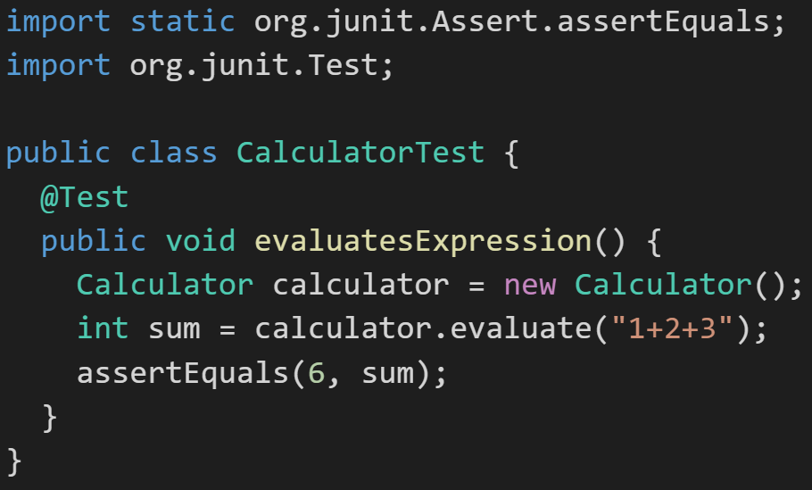
Automated Unit Testing Example: JUnit
Unit testing can be done in two ways − manual testing and automated testing.
JUnit [link] is a Automated Testing framework focused on developing and running Unit test for Java applications. JUnit:
Is a Java opensource extension
Provides annotations to identify test methods.
Provides assertions for testing expected results.
Provides test runners for running tests.
JUnit tests allow you to write codes faster, which increases quality.
JUnit is elegantly simple. It is less complex and takes less time.
JUnit tests can be run automatically and they check their own results and provide immediate feedback. There's no need to manually comb through a report of test results
Notes:
@Test
identifies the method as a test method (remember, method and function are synonyms)
@Test(expected = Exception.class)
fails if the method does not throw the named exception
@Test(timeout=100)
fails if the method takes longer than 100 milliseconds
@Before
public void method()
This method is executed before each test. It is used to prepare the test environment.
@After
public void method()
This method is executed after each test. It is used to clean up the test environment, including cleaning up expensive memory structures.
@BeforeClass
public static void method()
This method is executed once, before any test is done. It is used to do time-intensive tasks before any test is done.

Slide 41
Final Thoughts: Test-driven Development (TDD)
Notes:
Project Plans, Tracking, Managing

Slide 42
Assignment
ALL Assignments & Activity List Items are due this Sunday.
Prework assignments for next sprint will be communicated by Monday noon
Notes:
Grace period until Monday morning a 6am CT

Slide 43
Break & End of First Recording

Slide 44
Lab
As A Group:
Upon request for Friday

Slide 45
End of Session & Recordings

Slide 46
Backup Slides

Slide 47
Prioritize List and Consider Dependencies
Notes:
Who will volunteer to bring us a “Friendly Conversation” topic Thursday?

Slide 48
Demo of Sharing Repositories in GitHub …Thank you, John!
Notes:
Who will volunteer to bring us a “Friendly Conversation” topic Thursday?

Slide 49
Presentation Schedule for Tuesday, February 13:
Databases on Azure including “Azure tables vs Azure MongoDB vs Azure other DBs”
– by the Ocelots presented by Jake & Thad
JavaScript and NodeJS with a focus on Azure and including the best Internet based tutorials and/or books
– by the Great White Buffalos presented by Cris & Nick
Cloud/Azure based Authentication/Authorization services and how they could be integrated into a NodeJS based application
– by the Lewis Honeybadgers presented by Kevin and Louie
Databases on Azure including “Azure tables vs Azure MongoDB vs Azure other DBs”
– by the Back Row Bandicoots presented by Tyler and Joe
JavaScript and NodeJS with a focus on Azure and including the best Internet based tutorials and/or books
– by the Flamingos presented by Lenny
Note that presentations may carry over to Thursday as needed.

Slide 50
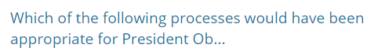
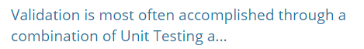
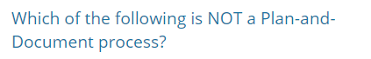
Assignment / Quiz Questions and Comments
Notes:
RUP… Scrum is only valid for a team of 3-8 (Scaled Agile would be valid but was not presented as an option
Verification is accomplished through Unit Testing… Validation is checking that an application fulfills the customer’s expectations
Waterfall, Spiral, and RUP are considered Plan-and-document processes

Slide 51
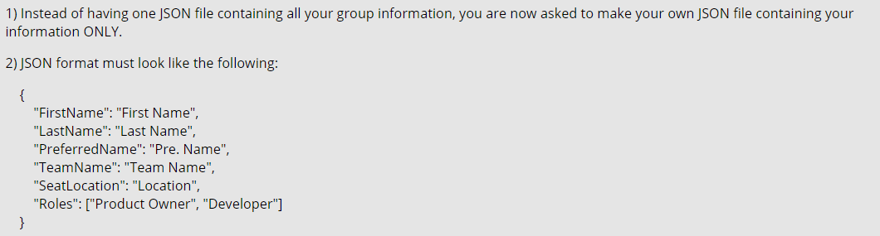
Class JSON Format
Specifications (per Ahmad and Product Owners):
Notes:
Do we want to “Scrum-ify” ourselves again… possibly with more a focused effort on technical specialization? Or should we keep the teams and team nams?
Possible Team Name categories:
Space Shuttles… nobody wanted to be Challenger
World War I battles in Europe… did not go very well
Thoughts?
Discussion Board items are ALWAYS due by Thursday at 11:59… You should include them in your own or your teams backlog (to-do list)
Excellent link for additional GitHub tutorials:
https://www.youtube.com/GitHubGuides

Slide 52
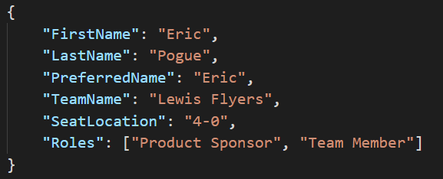
My “my-information.json” File
JSON URL: “http://sp18-cpsc-44000-001.azurewebsites.net/my-information.json”
Notes:
Do we want to “Scrum-ify” ourselves again… possibly with more a focused effort on technical specialization? Or should we keep the teams and team nams?
Possible Team Name categories:
Space Shuttles… nobody wanted to be Challenger
World War I battles in Europe… did not go very well
Thoughts?
Discussion Board items are ALWAYS due by Thursday at 11:59… You should include them in your own or your teams backlog (to-do list)
Excellent link for additional GitHub tutorials:
https://www.youtube.com/GitHubGuides

Slide 53
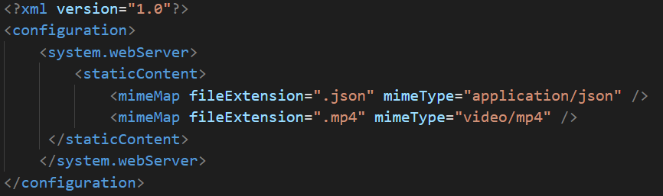
My “web.config” File
Notes:
Do we want to “Scrum-ify” ourselves again… possibly with more a focused effort on technical specialization? Or should we keep the teams and team nams?
Possible Team Name categories:
Space Shuttles… nobody wanted to be Challenger
World War I battles in Europe… did not go very well
Thoughts?
Discussion Board items are ALWAYS due by Thursday at 11:59… You should include them in your own or your teams backlog (to-do list)
Excellent link for additional GitHub tutorials:
https://www.youtube.com/GitHubGuides

Slide 55
Object-Oriented Programming within Various Development Methodologies
Notes:
Development Methodology and Software Development Lifecycle (SDLC) are often used interchangeably.
The Iterative development methodology is not depicted here as even the mainstays and inventors of the Iterative development methodology seem to be moving toward agile. Plus as Waterfall “holdouts” move, they seem to be moving directly toward Agile. Can you start to see my biases?
Development Methodologies (SDLCs) are a future Bonus Topic. There are several optional slides t the end of this deck. Let me know if you would like to have a more formal overview of the topic as part of this class. I have a passion in this area.
Object oriented-programming concepts/practices evolve and reprioritize depending on the development methodology.
For example, in Waterfall (as well as in Iterative) object-oriented design often play a critical role in the (big upfront) design activities. UML diagrams and project artifacts are often important to the overall project success. (opinion) Practical reality has been that these design artifacts often do not reflect the actual implementation and are rarely maintained or updated.
The Agile practitioners do not reject these design artifacts. However, the focus on shorter time horizons, evolving architecture, and working code changes the value proposition for object-oriented practices to more focus on the build, test, enhance activities.

Slide 56
Waterfall vs Iterative vs Agile
 | Waterfall | Iterative | Agile
References | United States Department of Defense: DOD-STD-2167A (1985) | Rational Unified Process (RUP) Open Unified Process | Scrum Kanban Scaled Agile Framework (SAFe)
Priorities | Planning and predictability | Architecture, modeling, and efficiency through early detection & fixing of issues | Responsiveness to feedback, efficiency through engineering practices, early detection & fixing of issues
Principles | Execute phases sequentially: Requirements Analysis Design Coding Testing and Operations Define and commit to Scope, Cost, and Timeline “early” Implement strict Change Control | Develop and test iteratively Manage requirements Use components Model visually Verify quality Control changes | Develop, test, deploy, and release iteratively Capture lightweight near term requirements Empower teams Allow requirements to evolve but maintain fixed timelines Apply engineering practices and systems thinking (e.g. TDD) Integrate early user feedback into remaining plan Maintain a collaborative approach between all stakeholders
Notes:
The views on testing and change management have changed dramatically as organizations have moved from Waterfall to Iterative to Agile development lifecycles.
Successful Agile (and Iterative) Development REQUIRES better application design, development techniques, and testing practices.
Testing and lack of defects are not the end goal. A higher quality more usable more cost effective product is the goal.

Slide 57
Testing Terms
Important testing terms include:
Unit Testing: developer testing their own code
Integration Testing: development team testing their full code
System Testing: multiple development teams testing a full system or systems
Performance Testing: testing performance at the Unit, Integration, and/or System level
Manual Testing: a person using the application often running test scenarios
Automated Testing: a group of automated tests that run on the application in the Unit, Integration, System, or Performance testing areas
UI Automated Testing attempts to exercise the application be reproducing user events (key & mouse events)
API Automated Testing occurs at the function/method API level (JUnit for example)

Slide 58
Testing Terms
Important testing terms (continued):
Verification: does the application perform as expected
Validation: does the application provide the business benefit that was expected
Behavioral Testing: verifying that the correct functions were called with the correct parameters
State Testing: focuses on the results of those calls

Slide 59
Automated Testing
Unit testing can be done in two ways − manual testing and automated testing.
Automated testing has become a more important part of effective software testing. The pros of Automated Testing include:
Repeatable tests that are quick to run and can support Iterative and Agile development
Very effective in validating environments and doing “smoke tests” to make sure a new build meets a minimal set of requirements
Supports Performance Testing very effectively
Finds range defects
Very inexpensive and quick to repeat testing and validate fixes
Various implications include UI, API, and Unit automation tests
Notes:
False positives versus valid defects found.
Manual Testing and Automated Testing can be supportive of each other.

Slide 60
Automated Testing
Unit testing can be done in two ways − manual testing and automated testing.
Some of the benefits of Automated Testing have been oversold. Some of the challenges include:
Developers only rarely can come up with scenarios in scripts that they would not already have tested in their unit testing… they often don’t know what they don’t know
UI focused Automated Testing (key & mouse events) are often challenging and create a great number of false-positives
API Level Automated Testing (REST) are often more useful and easier to maintain
Environmental verification, API, and finally UI Automated testing is generally the best order to show value quickly with Automated Testing
Automated Testing investment is often not prioritized or tracked so it is difficult to know its effectiveness
Scripts can be expensive to develop and maintain
Notes:
False positives versus valid defects found.
Manual Testing and Automated Testing can be supportive of each other.

Slide 61
Automated Unit Testing Example: JUnit
Unit testing can be done in two ways − manual testing and automated testing.
JUnit [link] is a Automated Testing framework focused on developing and running Unit test for Java applications. JUnit:
Is a Java opensource extension
Provides annotations to identify test methods.
Provides assertions for testing expected results.
Provides test runners for running tests.
JUnit tests allow you to write codes faster, which increases quality.
JUnit is elegantly simple. It is less complex and takes less time.
JUnit tests can be run automatically and they check their own results and provide immediate feedback. There's no need to manually comb through a report of test results
Notes:
@Test
identifies the method as a test method (remember, method and function are synonyms)
@Test(expected = Exception.class)
fails if the method does not throw the named exception
@Test(timeout=100)
fails if the method takes longer than 100 milliseconds
@Before
public void method()
This method is executed before each test. It is used to prepare the test environment.
@After
public void method()
This method is executed after each test. It is used to clean up the test environment, including cleaning up expensive memory structures.
@BeforeClass
public static void method()
This method is executed once, before any test is done. It is used to do time-intensive tasks before any test is done.

Slide 62
“What is the primary impact of using an Agile SDLC and an application’s Architecture?"
Notes:
Utilizing an Agile Software Development Lifecycle forces an application’s (or system’s) architecture to demonstrate validity much much earlier. Failing sooner can save a massive amount of money.

Slide 63
Discussion: “What has been your experience with technology & architecture metrics? Or metrics in general?”

Slide 64
Software Quality Metrics
Discuss the following items related to Software Quality Metrics
Software Quality vs Architecture Quality
Software Metrics Best Practices
Consider using trends instead of (or in addition to) absolute numbers
Consider surveys results when hard day is challenging
Common Software Metrics
Measuring Output to Normalizing Metrics… and to estimate
Favorite Metric – Improve Weighted Average Defect Density
Case Study – EQUIP Metrics and Goals
Notes:
Discuss Functional vs. Non-functional
External vs Internal
Technical Debt
Metrics
Because if you don’t invest in non-functional quality attributes, you will not be able to deliver your functional quality attributes effectively going forward.
Simple and computable
Consistent and unambiguous (objective)
Use consistent units of measurement
Independent of programming languages
Easy to calibrate and adaptable
Easy and cost-effective to obtain
Able to be validated for accuracy and reliability
Relevant to the development of high-quality software products
Link software metrics to goals. Often sets of software metrics are communicated to software development teams as goals. ...
Track trends, not numbers. ...
Set shorter measurement periods. ...
Stop using software metrics that do not lead to change.
Formal code metrics—Such as Lines of Code (LOC), code complexity, Instruction Path Length, etc. In modern development environments, these are considered less useful.
Developer productivity metrics—Such as active days, assignment scope, efficiency and code churn. These metrics can help you understand how much time and work developers are investing in a software project.
Agile process metrics—Such as lead time, cycle time and velocity. They measure the progress of a dev team in producing working, shipping-quality software features.
Operational metrics—Such as Mean Time Between Failures (MTBF) and Mean Time to Recover (MTTR). This checks how software is running in production and how effective operations staff are at maintaining it.
Test metrics—Such as code coverage, percent of automated tests, and defects in production. This measures how comprehensively a system is tested, which should be correlated with software quality.
Customer satisfaction—Such as Net Promoter Score (NPS), Customer Effort Score (CES) and Customer Satisfaction Score (CSAT). The ultimate measurement of how customers experience the software and their interaction with the software vendor.

Slide 65
Metrics
What makes bad metrics?
Can drive bad behavior or are easy to “game”
Allows one group to declare success (project management, architecture, business analysts, etc.) while the overall project is failing

Slide 66
Common Metrics for Software Development
Line of code per time-period
On-time
On-budget
… Scope delivered
Defects
Weighted Defects
Weighted Defects per unit delivered
Unit delivered per hour/day/month… per person
Unit delivered per hour/day/month… per dollar

Slide 67
Common Metrics for Agile Software Development
Story Points per Sprint per person
Say/Do ratio
Story Points delivered per Sprint… change in Story Points delivered per Sprint
Team versatility
Percent coverage with automated testing… or TDD
Satisfaction surveys (internal or external)
Eric’s Favorite: Weighted Defect Density per 10,000 hours worked… production

Slide 68
Metrics Recommendations
Distinguish between organizational level, team level, and team roll-up metrics
Distinguish between optional and mandatory metrics (insist on compliance with mandatory)
Start small… very few but high-quality mandatory metrics
Provide and reward (and insist on) transparency
NEVER use metrics to punish a team… reward them for being transparent with painful metrics
Promote metrics that are working well for several teams to roll-up and/or mandatory metrics
Be VERY careful about metrics that attempt to directly or indirectly measure productivity across teams… they are complex, expensive, have low confidence, and can cause negative behavior
Consider productivity improvement metrics as a less painful alternative

Slide 69
Measuring Team Output… and Estimating/Planning
Be wary! No, be afraid!!
Story Points
Use Case Points
Function Points
Notes:
References:
https://www.ibm.com/developerworks/library/d-estimation-agile-or-conventional-trs/index.html
https://tcagley.wordpress.com/2013/11/06/questions-i-am-frequently-asked-what-is-the-difference-between-story-points-and-function-points/
https://tcagley.wordpress.com/2013/11/05/questions-i-am-frequently-asked-what-is-a-function-point/
https://en.wikipedia.org/wiki/Planning_poker

Slide 70
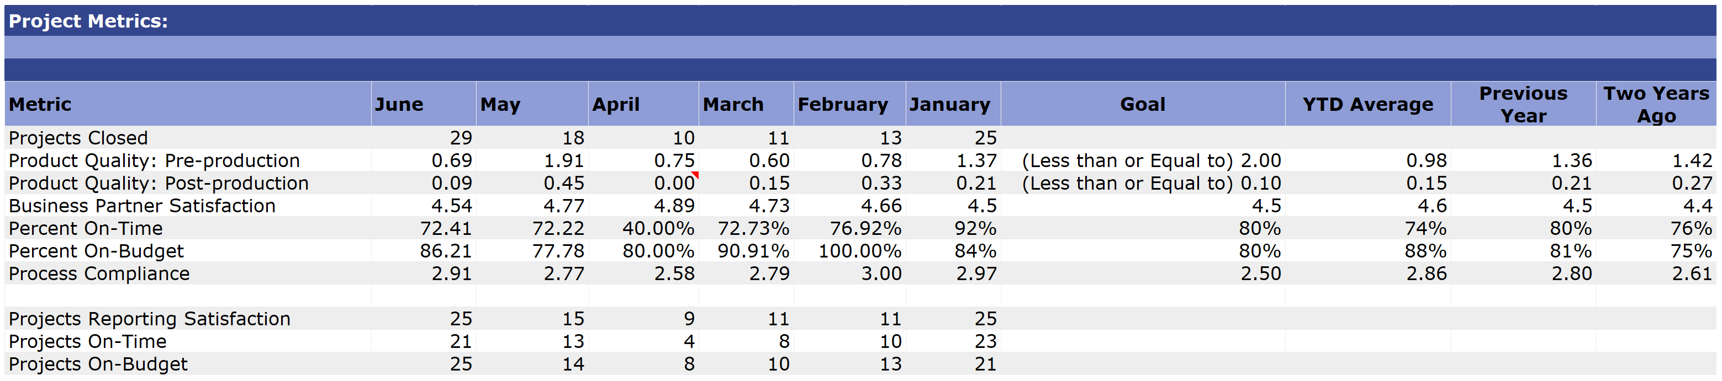
Example Metrics Scorecard

Slide 71
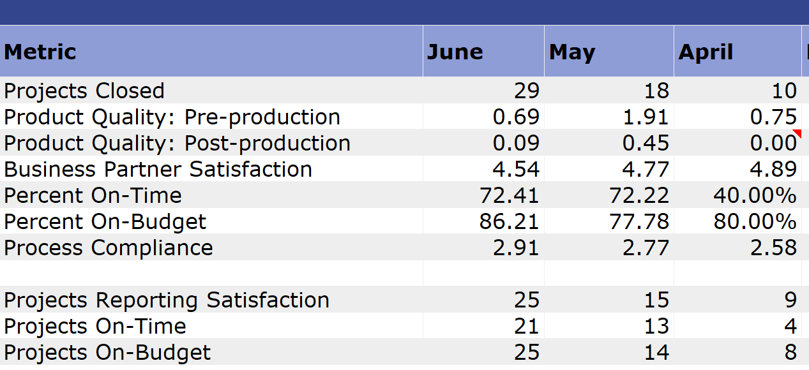
Notes:
On-Time and On-Budget and Change Requests
Business Partner Satisfaction Game-ability… India experience

Slide 72
Improve Weighted Average Defect Density
Notes:
Utilizing an Agile Software Development Lifecycle forces a application’s (or system’s) architecture to demonstrate validity much much earlier. Failing sooner can save a massive amount of money.

Slide 73
Preview Case Study – EQUIP Architecture & Metrics
Notes:
Utilizing an Agile Software Development Lifecycle forces a application’s (or system’s) architecture to demonstrate validity much much earlier. Failing sooner can save a massive amount of money.

Slide 74


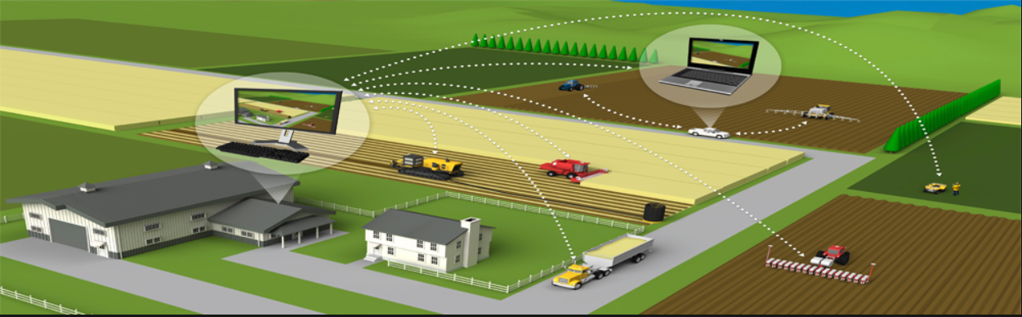



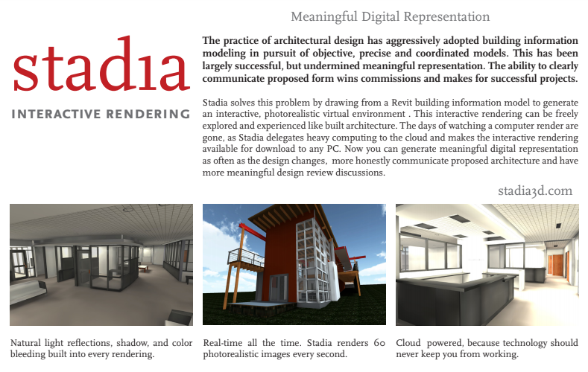

Slide 76
People, Process, and Technology
Software Engineering:
People: Leadership, Domain Knowledge, Organization Structure, Enterprise Processes (budgeting, portfolio management, etc.)… Mythical all knowing “The Business”
Process: Waterfall/Iterative/Agile Software Development Lifecycle (SDLC), Project Management, Project Metrics, Role Identification/Assignment
Technology: Usability, Architecture, Configuration Management, Cloud Hosting, Scriptable Infrastructure, Source Code Management, Automated Testing, Development Team Staffing
Notes:
Eric’s View

Slide 77


Model-View-Controller (MVC)
Diagram of interactions within the MVC pattern.
Model–view–controller is an architectural pattern commonly used for developing user interfaces that divides an application into three interconnected parts. This is done to separate internal representations of information from the ways information is presented to and accepted from the user.[1][2] The MVC design pattern decouples these major components allowing for efficient code reuse and parallel development.
Traditionally used for desktop graphical user interfaces (GUIs), this architecture has become popular for designing web applications and even mobile, desktop and other clients.[3] Popular programming languages like Java, C#, Ruby, PHP have MVC frameworks that are used in web application development straight out of the box

Slide 78
Containers & Docker [link]

Slide 79
Kubernetes & Swarm [link]

Slide 80
MVC Web Frameworks

Slide 81
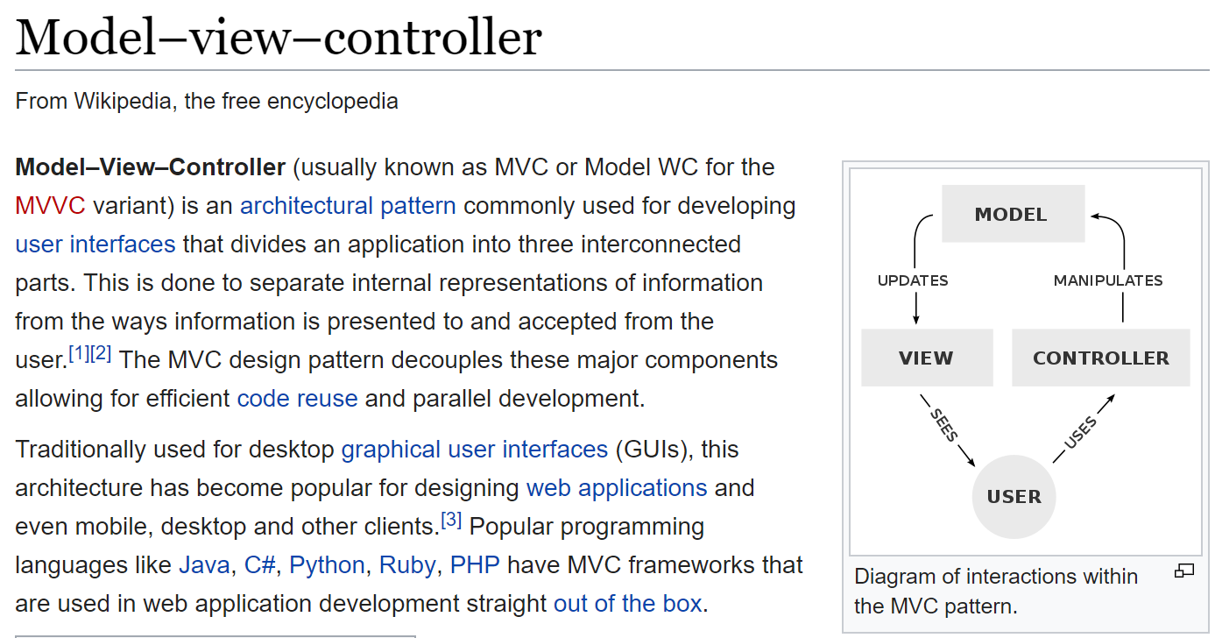
MVC Pattern

Slide 82
Django MVC or MVT?
Yes. The main difference is that Django takes care of the Controller by introducing Templates that we are expected to implement.

Slide 83
Friendly Conversation Topic – Bandwidth versus Latency

Slide 84
Network Architecture & Protocols

Slide 85
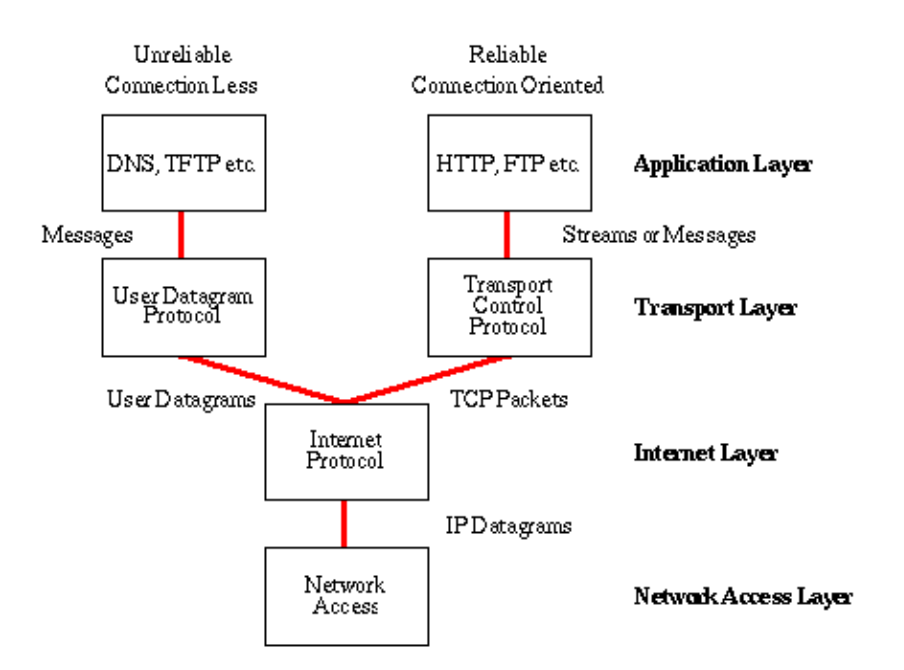
Network Architecture – The Internet
The Internet [link]
IP (Internet Protocol) [link]
TCP (Transmission Control Protocol) [link]
TCP/IP
UDP (User Datagram Protocol) [link]
UDP/IP
TCP/IP or UDP/IP Socket [link]
TCP and UDP Protocols & Port Numbers [link]

Slide 86
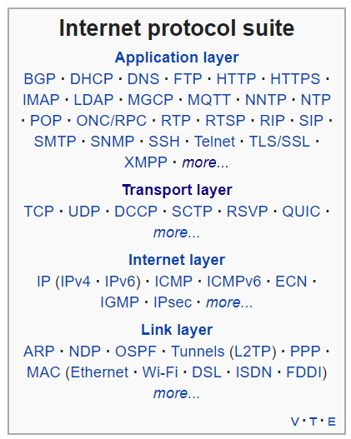
Network Architecture – The Web
The Web [link]
HTTP (Hypertext Transfer Protocol) [link]
DNS (Domain Name System) [link]
HTML (Hypertext Markup Language) [link]
CSS (Cascading Style Sheets) [link]
JavaScript [link]
Internet Protocol Suite [link]

Slide 87
Network Architecture – Distributed Computing
RPC (Remote procedure call) [link]
… SOA (service-oriented architecture) version 1
Java RMI (Java remote method invocation) [link]
DCOM (Distributed Component Object Model) [link]
CORBA (Common Object Request Broker Architecture) [link]
… [The Web takes over the world]
XML (Extensible Markup Language) [link]
XML-RPC (XML & HTTP) [link]
Internet Protocol Suite [link]

Slide 88
Network Architecture – Web Services
Web Services [link]
…SOA (service-oriented architecture) version 2
XML (Extensible Markup Language) [link]
XML-RPC (XML & HTTP) [link]
SOAP (Simple Object Access Protocol) [link]
JSON (JavaScript Object Notation) [link]
REST (Representational State Transfer) [link]
Internet Protocol Suite [link]

Slide 89
Network Architecture – Back to the Future
Web Services [link]
…SOA (service-oriented architecture) version 2 [link]
JSON (JavaScript Object Notation) [link]
REST (Representational State Transfer) [link]
gRPC [link] Or https://grpc.io/faq/
REST vs gRPC
REST vs. gRPC: Battle of the APIs [link]
Evaluating Performance of REST vs. gRPC [link]
Internet Protocol Suite [link]

Slide 90
Network Architecture – The Internet
The Internet [link]
IP (Internet Protocol) [link]
TCP (Transmission Control Protocol) [link]
TCP/IP
UDP (User Datagram Protocol) [link]
UDP/IP
TCP/IP or UDP/IP Socket [link]
TCP and UDP Protocols & Port Numbers [link]

Slide 91
Network Architecture – The Web
The Web [link]
HTTP (Hypertext Transfer Protocol) [link]
DNS (Domain Name System) [link]
HTML (Hypertext Markup Language) [link]
CSS (Cascading Style Sheets) [link]
JavaScript [link]

Slide 92
Network Architecture – Distributed Computing
RPC (Remote procedure call) [link]
… SOA (service-oriented architecture) version 1
Java RMI (Java remote method invocation) [link]
DCOM (Distributed Component Object Model) [link]
CORBA (Common Object Request Broker Architecture) [link]
…
XML (Extensible Markup Language) [link]
XML-RPC (XML & HTTP) [link]

Slide 93
Network Architecture – Web Services
Web Services [link]
…SOA (service-oriented architecture) version 2 [link]
XML (Extensible Markup Language) [link]
XML-RPC (XML & HTTP) [link]
SOAP (Simple Object Access Protocol) [link]
JSON (JavaScript Object Notation) [link]
REST (Representational State Transfer) [link]
https://en.wikipedia.org/wiki/GRPC

Slide 94
Network Architecture – Back to the Future
JSON (JavaScript Object Notation) [link]
REST (Representational State Transfer) [link]
gRPC [link]
REST vs gRPC
REST vs. gRPC: Battle of the APIs [link]
Evaluating Performance of REST vs. gRPC [link]

Slide 95
Friendly Conversation Topic – In-demand Software Development Skills [link]

Slide 96
Your Feedback from Sprint 6? APIs? Swagger? YAML?
Notes:
Lab API assignment?

Slide 98
Case Study – EQUIP Architecture Patterns, Tactics, and Metrics

Slide 101

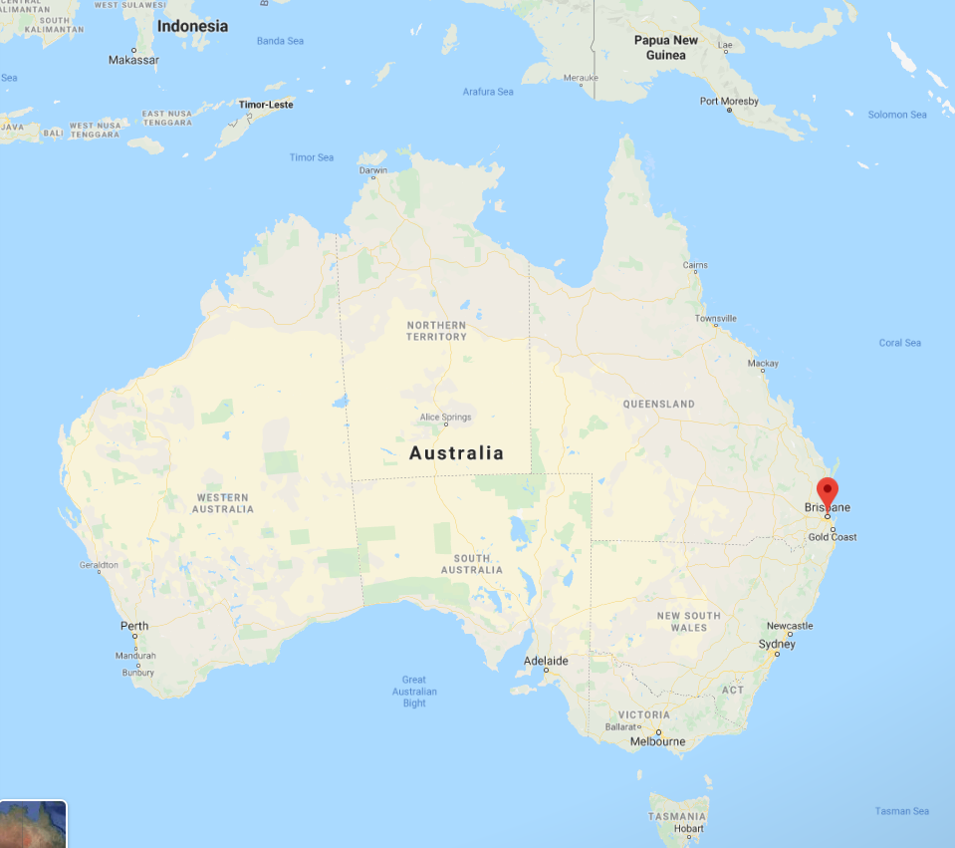


Notes:
Chicago
Los Angeles
Brisbane
Melbourne
Singapore
Mumbai
Frankfort
Chicago

Slide 102
EQUIP Architecture Review (2006)
Notes:
Architecture Pattern: PowerBuilder (client-server quick development)
Tactics: Maximize Feature Output
Configuration Management… Updates
Encapsulation
Small scale client server pattern deployed on large scale

Slide 103
EQUIP Architecture Review (2006)
Architecture Review Findings:
Architectural Pattern: Small scale client-server PowerBuilder/Sybase hosted on Citrix delivered to large customer base (Toyota dealers, John Deere dealers, and many other
Tactics: Deliver More Features (consider external/functional requirements only)
Quality Attribute Priorities: “Usability” and new functionality at any cost
Quality Issues: Reliability, Modifiability, Performance, Testability
“It looks like they have been programming for the last years as if they only had two weeks to live”
Waterfall process with year plus releases often delayed
Configuration management and deployment issues

Slide 104
The Right-eous Triangle Perspective
People & Organization
Technology & Tools
Process & Roles

Slide 105
…Four Years Go By…
Notes:
Architecture Pattern: PowerBuilder (client-server quick development)
Tactics: Maximize Feature Output

Slide 106
That Fateful Day (2010)

Slide 107
The Right-eous Triangle Perspective
People & Organization
Technology & Tools
Process & Roles
Notes:
Created an alliance with Product Management (Jeremy)
Replace a project manager who had resigned with an Architect and hired a Manager/Architect into a development team supervisory spot
Combined Delivery and Project Management teams
Implemented Agile
Consolidated development within the company

Slide 108
And Then

Slide 109
It Got Worse

Slide 110
EQUIP Architecture Review (2011)
Architecture Review Findings:
Architectural Patterns: Small scale client-server PowerBuilder/Sybase hosted on Citrix delivered to a smaller customer base of John Deere dealers
Strangler Pattern to encapsulate sections of functionality and move it to a multi-tier pattern with .NET environment and Web access
Tactics: Deliver More Features (consider external/functional requirements only) Stop breaking sh-t by only making safe fixes (prioritize defects by safe-fix criteria), Multi-GL only new feature, agile releases every few months, Genba*
Quality Attribute Priorities: Performance is the new Usability, Reliability, and Testability
Personal Skill Improvement: I learned how to apologize with the best of them… and how to listen

Slide 111
Metrics 1.0

Slide 112
Defects Introduced By Release… Introduce Fewer Defects

Slide 113
Metrics 2.0

Slide 114
Defects Introduced and Fixed By Release through 15 May 2012

Slide 115
Metrics 3.0

Slide 116
EQUIP Open Production Defects by Date & Criticality
Notes:
Function Points, Use Case Points, and Story Points

Slide 117
EQUIP Open Production Defects by Date & Criticality
EQUIP 12.2

Slide 118
EQUIP 12.2 Open Production Defects by Sprint
Notes:
Function Points, Use Case Points, and Story Points

Slide 119
EQUIP 12.2 Story Points Delivered by Sprint

Slide 120
The Right-eous Triangle of Software Development
People & Organization
Technology & Tools
Process & Roles

Slide 121
EQUIP Brazil?
Notes:
Architecture Pattern: PowerBuilder (client-server quick development)
Tactics: Reliability, Performance, Maintainability
Focus & Periodization: Only Multi-GL (saying “no”)

Slide 123
More SAFe and how SDLCs impact testing
Notes:
Who will volunteer to bring us a “Friendly Conversation” topic Thursday?

Slide 124
Software Testing Overview
Software Testing [link] is important because, if done right, it can help us find and fix problems earlier and make our system delivery process less immobile, rigid, and fragile.
As future Software Engineers , we are going to:
Understand testing within the various Software Development Lifecycles
Understand testing terminology
Know how to develop applications that are easier to test
Understand Unit Testing and Automated Testing
Notes:
Never underestimate the value of good design and implementation (for testability, encapsulation, etc.) on the economics of testing. You can’t afford to test in quality!
Developers are responsible for product quality. Tester should be able to minimize that chance that a defect makes it to production.
We test to find defects and/or to validate that we have not introduced new defects.
Defects are exponentially more expensive to fix the longer the exist.
Performance issues are often the most difficult and expensive defects to fix. They are often not found until the application if running under production load… which is often only when it is in production.
Unit - $200
Integration - $600
User Acceptance - $6,000
Production - $100,000+
The permutations of modern software features, data, tools, environments, etc. quickly becomes unmanageable. Testability needs to be goal of nearly all non-trivial applications.
Dave Cutler of Windows NT fame had a quote. I wish I could remember the exact words, but it went something like, “I hate having testers because they give developers the false hope that someone else can save them from their sins.”

Slide 125
Software Testing “Truths”
Never underestimate the value of good design and implementation (for testability, encapsulation, etc.) on the economics of testing… You can’t afford to test in quality!
Defects are exponentially more expensive to fix the longer the exist.
Unit - $200
Integration - $600
User Acceptance - $6,000
Production - $100,000+
Performance issues are often the most difficult and expensive defects to fix. They are often not found until the application if running under production load… which is often only when it is in production.
The permutations of modern software features, data, tools, environments, etc. quickly becomes unmanageable. Testability needs to be goal of nearly all non-trivial applications.
Developers need to be responsible for product quality. Tester should be able to minimize that chance that a defect makes it to production.
Dave Cutler of Windows NT fame had a quote. I wish I could remember the exact words, but it went something like, “I hate having testers because they give developers the false hope that someone else can save them from their sins.”

Slide 126
Object-Oriented Programming within Various Development Methodologies
Notes:
Development Methodology and Software Development Lifecycle (SDLC) are often used interchangeably.
The Iterative development methodology is not depicted here as even the mainstays and inventors of the Iterative development methodology seem to be moving toward agile. Plus as Waterfall “holdouts” move, they seem to be moving directly toward Agile. Can you start to see my biases?
Development Methodologies (SDLCs) are a future Bonus Topic. There are several optional slides t the end of this deck. Let me know if you would like to have a more formal overview of the topic as part of this class. I have a passion in this area.
Object oriented-programming concepts/practices evolve and reprioritize depending on the development methodology.
For example, in Waterfall (as well as in Iterative) object-oriented design often play a critical role in the (big upfront) design activities. UML diagrams and project artifacts are often important to the overall project success. (opinion) Practical reality has been that these design artifacts often do not reflect the actual implementation and are rarely maintained or updated.
The Agile practitioners do not reject these design artifacts. However, the focus on shorter time horizons, evolving architecture, and working code changes the value proposition for object-oriented practices to more focus on the build, test, enhance activities.

Slide 128
Waterfall vs Iterative vs Agile
 | Waterfall | Iterative | Agile
References | United States Department of Defense: DOD-STD-2167A (1985) | Rational Unified Process (RUP) Open Unified Process | Scrum Kanban Scaled Agile Framework (SAFe)
Priorities | Planning and predictability | Architecture, modeling, and efficiency through early detection & fixing of issues | Responsiveness to feedback, efficiency through engineering practices, early detection & fixing of issues
Principles | Execute phases sequentially: Requirements Analysis Design Coding Testing and Operations Define and commit to Scope, Cost, and Timeline “early” Implement strict Change Control | Develop and test iteratively Manage requirements Use components Model visually Verify quality Control changes | Develop, test, deploy, and release iteratively Capture lightweight near term requirements Empower teams Allow requirements to evolve but maintain fixed timelines Apply engineering practices and systems thinking (e.g. TDD) Integrate early user feedback into remaining plan Maintain a collaborative approach between all stakeholders
Notes:
The views on testing and change management have changed dramatically as organizations have moved from Waterfall to Iterative to Agile development lifecycles.
Successful Agile (and Iterative) Development REQUIRES better application design, development techniques, and testing practices.
Testing and lack of defects are not the end goal. A higher quality more usable more cost effective product is the goal.

Slide 129
Testing Terms
Important testing terms include:
Unit Testing: developer testing their own code
Integration Testing: development team testing their full code
System Testing: multiple development teams testing a full system or systems
Performance Testing: testing performance at the Unit, Integration, and/or System level
Manual Testing: a person using the application often running test scenarios
Automated Testing: a group of automated tests that run on the application in the Unit, Integration, System, or Performance testing areas
UI Automated Testing attempts to exercise the application be reproducing user events (key & mouse events)
API Automated Testing occurs at the function/method API level (JUnit for example)

Slide 130
Testing Terms
Important testing terms (continued):
Verification: does the application perform as expected
Validation: does the application provide the business benefit that was expected
Behavioral Testing: verifying that the correct functions were called with the correct parameters
State Testing: focuses on the results of those calls

Slide 131
Automated Testing
Unit testing can be done in two ways − manual testing and automated testing.
Automated testing has become a more important part of effective software testing. The pros of Automated Testing include:
Repeatable tests that are quick to run and can support Iterative and Agile development
Very effective in validating environments and doing “smoke tests” to make sure a new build meets a minimal set of requirements
Supports Performance Testing very effectively
Very inexpensive and quick to repeat testing and validate fixes
Various implications include UI, API, and Unit automation tests… each has a very different set of pros and cons
Notes:
False positives versus valid defects found.
Manual Testing and Automated Testing can be supportive of each other.

Slide 132
Automated Testing
Unit testing can be done in two ways − manual testing and automated testing.
Some of the benefits of Automated Testing have been oversold. Some of the challenges include:
Developers rarely can come up with scenarios in scripts that they would not already have tested in their normal unit testing… they often don’t know what they don’t know
UI focused Automated Testing (key & mouse events) are often challenging and create/maintain a great number of false-positives
API Level Automated Testing (i.e. REST) scripts are often more useful and easier to maintain
Environmental verification, API, and finally UI Automated testing is generally the best order to show value quickly with Automated Testing
Automated Testing investment is often not prioritized or tracked so it is difficult to know its effectiveness
Scripts can be expensive to develop and maintain
Notes:
False positives versus valid defects found.
Manual Testing and Automated Testing can be supportive of each other.

Slide 133
Automated Unit Testing Example: JUnit
Unit testing can be done in two ways − manual testing and automated testing.
JUnit [link] is a Automated Testing framework focused on developing and running Unit test for Java applications. JUnit:
Is a Java opensource extension
Provides annotations to identify test methods.
Provides assertions for testing expected results.
Provides test runners for running tests.
JUnit tests allow you to write codes faster, which increases quality.
JUnit is elegantly simple. It is less complex and takes less time.
JUnit tests can be run automatically and they check their own results and provide immediate feedback. There's no need to manually comb through a report of test results
Notes:
@Test
identifies the method as a test method (remember, method and function are synonyms)
@Test(expected = Exception.class)
fails if the method does not throw the named exception
@Test(timeout=100)
fails if the method takes longer than 100 milliseconds
@Before
public void method()
This method is executed before each test. It is used to prepare the test environment.
@After
public void method()
This method is executed after each test. It is used to clean up the test environment, including cleaning up expensive memory structures.
@BeforeClass
public static void method()
This method is executed once, before any test is done. It is used to do time-intensive tasks before any test is done.

Slide 134
Lab (report-out at 12:08)
Lab Activities:
I need two volunteers to demo setting up a local NodeJS application… you can record it and submit the recording if you prefer
I need two volunteers to demo setting up a Azure NodeJS application… you can record it and submit the recording if you prefer
Complete initial Sprint 4 Discussion Board (DB) post… during class
Review and respond back (test/verify) to at least one DB post from a classmate… during class
Submit ALL completed Presentations, Demos, and Roles played by the end of the day
Work on Team Backlog items
Notes:
Sprints: 2 Week periods where deliverables are due and demos should be complete
Story Points (SP): Estimate of work that should be based on example deliverables. Generally not normalized between groups or teams. We will utilize ~30min to equal 1 SP
Hand out sprint planning sheet… 1 sheet per team

Slide 136
Software Metrics, Estimating, and Measuring Output
A model is a simplification or approximation of reality and hence will not reflect all of reality. ... Box noted that “all models are wrong, but some are useful.” While a model can never be “truth,” a model might be ranked from very useful, to useful, to somewhat useful to, finally, essentially useless. – George Box
Notes:
Who will volunteer to bring us a “Friendly Conversation” topic Thursday?

Slide 137
Software Metrics, Estimating, and Measuring Output
A model is a simplification or approximation of reality and hence will not reflect all of reality. ... Box noted that “all models are wrong, but some are useful.” While a model can never be “truth,” a model might be ranked from very useful, to useful, to somewhat useful to, finally, essentially useless. – George Box
Notes:
Who will volunteer to bring us a “Friendly Conversation” topic Thursday?

Slide 138
Metrics
What makes a good metric?
Easy to measure and understand
Good approximation of reality… good correlation to performance
Drives positive behavior/action
Discourages “gaming the system”… and the impact of “gaming” is limited
Meaningful to the group that can impact the measurement
Comparable to other teams or companies

Slide 139
Common Metrics for Software Development
Line of code per time-period
On-time
On-budget
… Scope delivered
Defects
Weighted Defects
Weighted Defects per unit delivered
Unit delivered per hour/day/month… per person
Unit delivered per hour/day/month… per dollar

Slide 140
Common Metrics for Agile Software Development
Story Points per Sprint per person
Say/Do ratio
Story Points delivered per Sprint… change in Story Points delivered per Sprint
Team versatility
Percent coverage with automated testing… or TDD
Satisfaction surveys (internal or external)
Eric’s Favorite: Weighted Defect Density per 10,000 hours worked… production

Slide 141
Metrics Recommendations
Distinguish between organizational level, team level, and team roll-up metrics
Distinguish between optional and mandatory metrics (insist on compliance with mandatory)
Start small… very few but high quality mandatory metrics
Provide and reward (and insist on) transparency
NEVER use metrics to punish a team… reward them for being transparent with painful metrics
Promote metrics that are working well for several teams to roll-up and/or mandatory metrics
Be VERY careful about metrics that attempt to directly or indirectly measure productivity across teams… they are complex, expensive, have low confidence, and can cause negative behavior
Consider productivity improvement metrics as a less painful alternative

Slide 142
Release/PSI Planning
Notes:
Who will volunteer to bring us a “Friendly Conversation” topic Thursday?

Slide 144
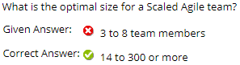
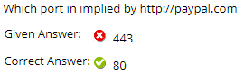
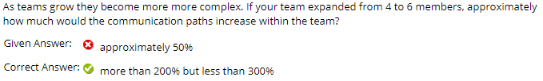
Exam 1 Feedback

Slide 145
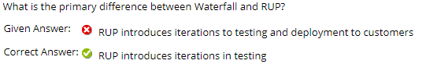
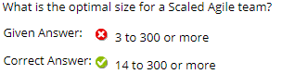
Exam 1 Feedback

Slide 146
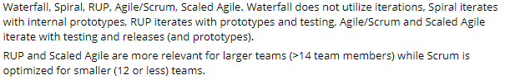
Exam 1 Feedback

Slide 147
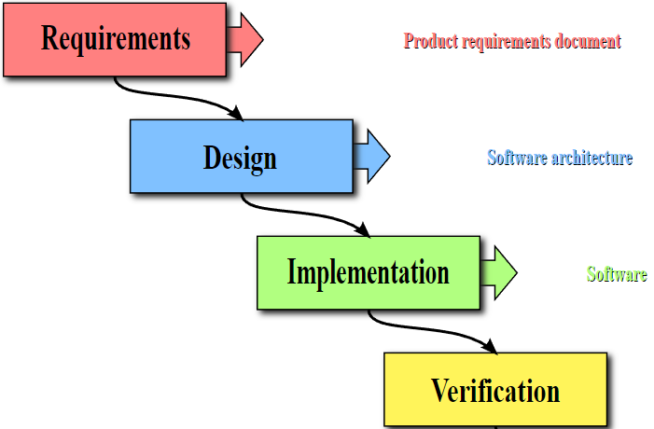
40%
50%
60%
50%
Notes:
The process encourages the promotion of whatever activities/skills a given group or individual possesses

Slide 148
Observation
Notes:
Who will volunteer to bring us a “Friendly Conversation” topic Thursday?

Slide 149
40%
50%
60%
50%
Notes:
The process encourages the promotion of whatever activities/skills a given group or individual possesses

Slide 150
15%
85%
Notes:
The physics of getting work done help the team(s) self organize/optimize

